Slide 1




Building the Engine of Community Development in Detroit
All Stakeholder Convening
October 26, 2016

Slide 2

Building the Engine of Community Development in Detroit
ALL – STAKEHOLDER CONVENING
GOALS FOR THE DAY
BECDD participants will be informed on the results of the process to date
Consensus if possible, on the “Big Questions.” If not consensus, clarity on where we disagree
Participants will have provided more insight on the suggested framework: its content and next steps for Phase Two of Building the Engine

Slide 3
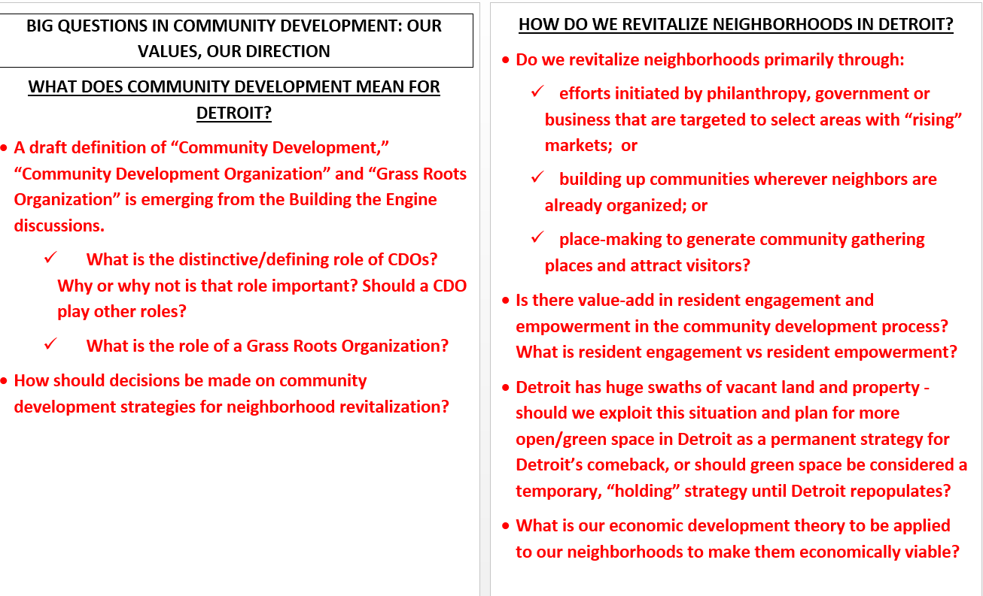
Building the Engine of Community Development in Detroit

Slide 4
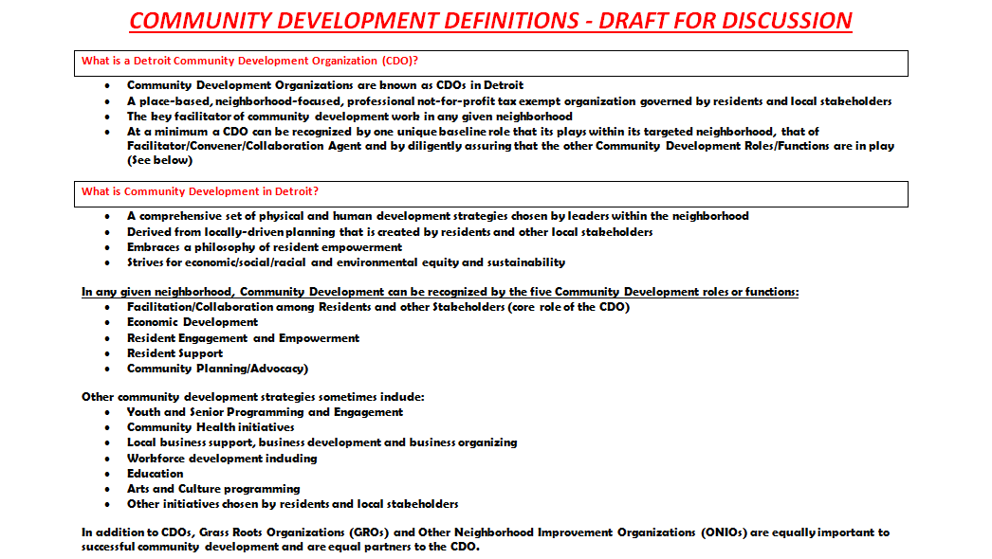
Building the Engine of Community Development in Detroit

Slide 5
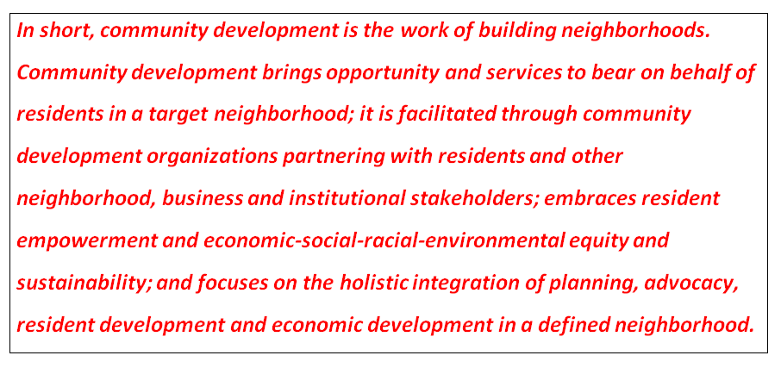
Building the Engine of Community Development in Detroit

Slide 6
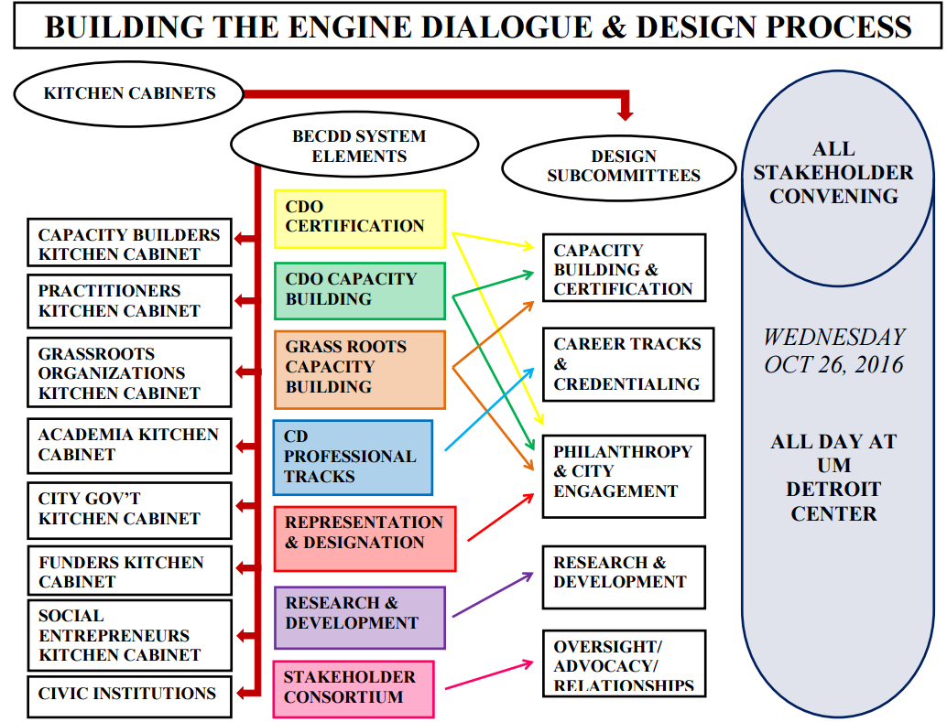
Building the Engine of Community Development in Detroit

Slide 7
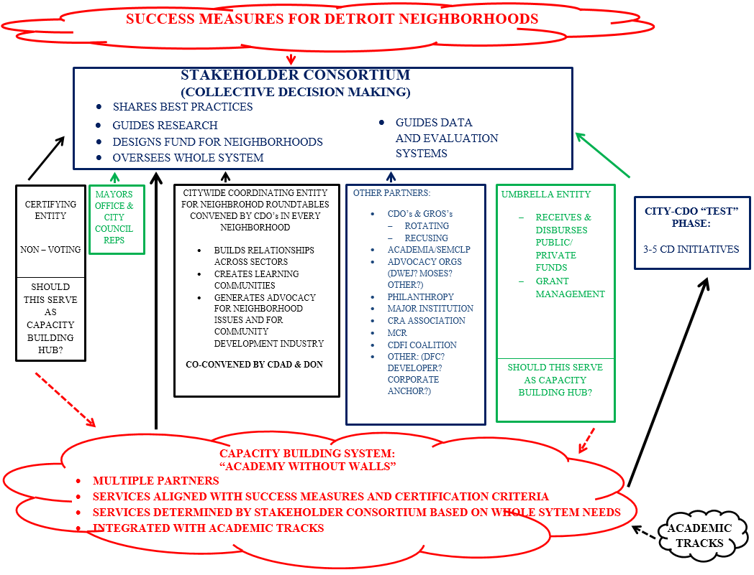
Building the Engine of Community Development in Detroit

Slide 8
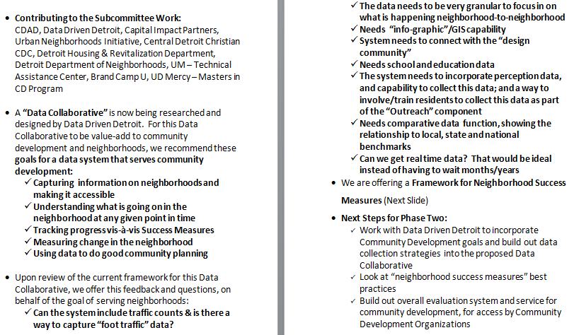
REPORT FROM THE RESEARCH & DEVELOPMENT SUBCOMMITTEE
Building the Engine of Community Development in Detroit

Slide 9
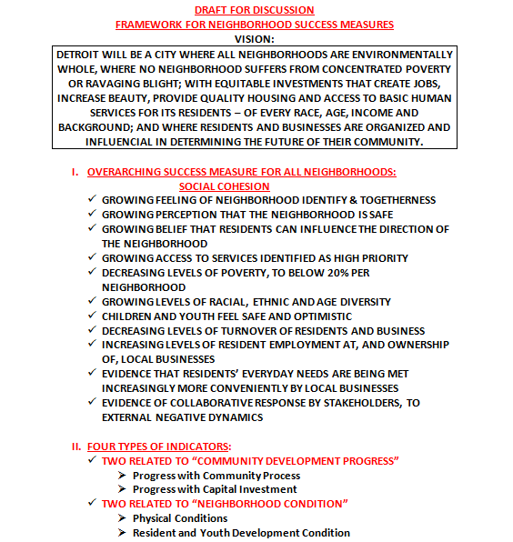
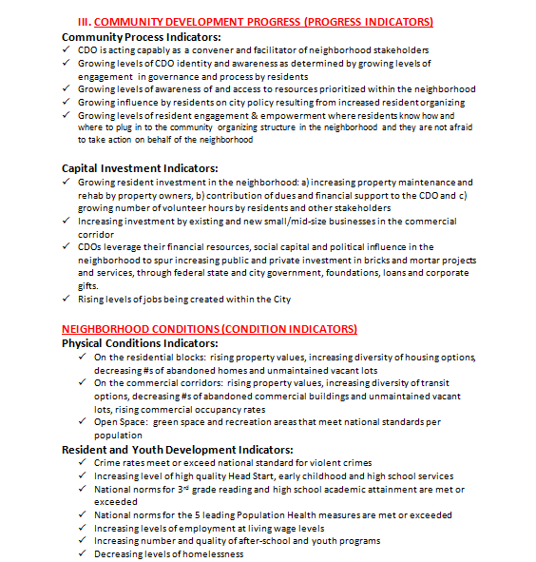
REPORT FROM THE RESEARCH & DEVELOPMENT SUBCOMMITTEE
Building the Engine of Community Development in Detroit

Slide 10
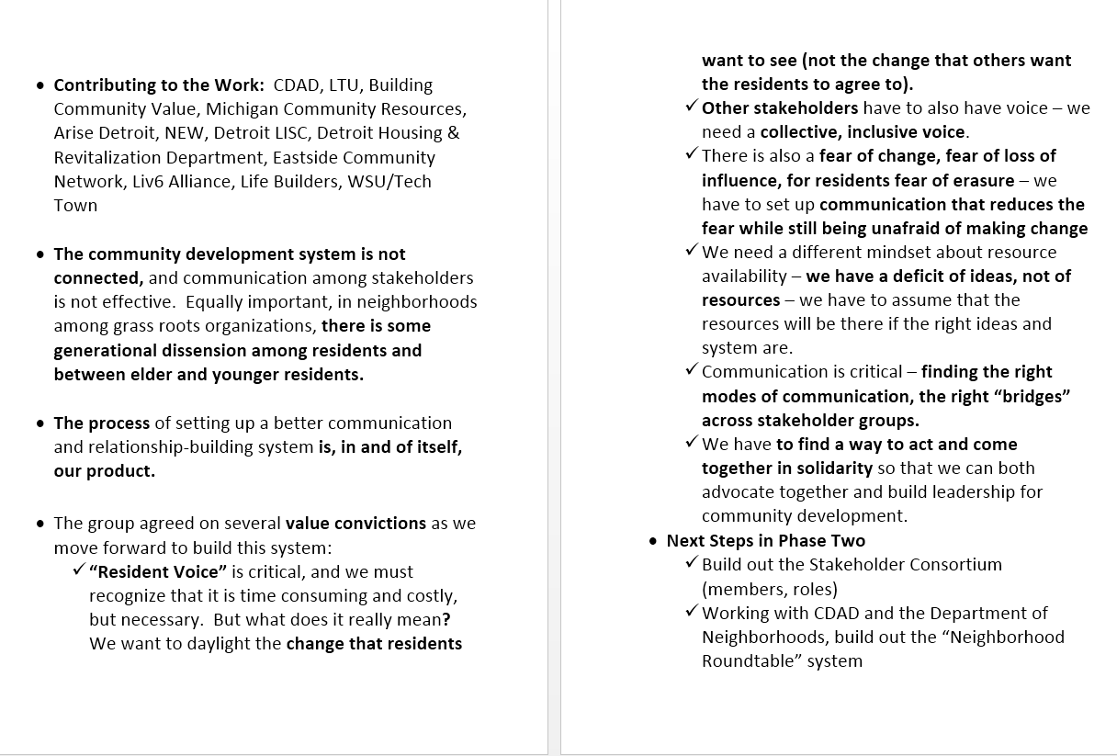
REPORT FROM THE OVERSIGHT, ADVOCACY & RELATIONSHIPS SUBCOMMITTEE
Building the Engine of Community Development in Detroit

Slide 11
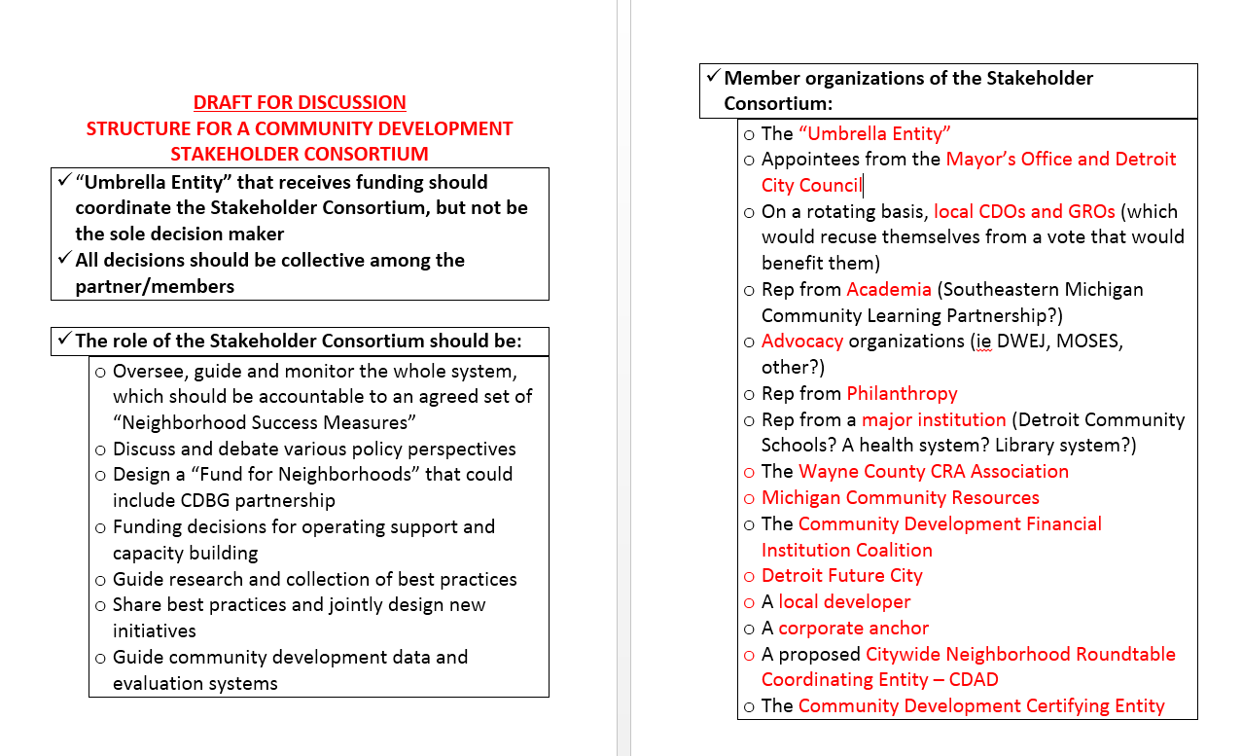
STAKEHOLDER CONSORTIUM
Building the Engine of Community Development in Detroit

Slide 12
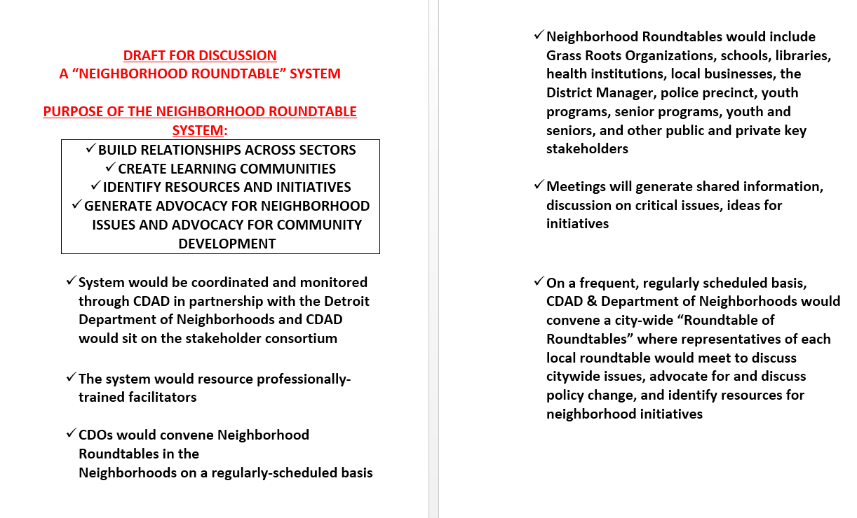
Neighborhood Roundtable System
Building the Engine of Community Development in Detroit

Slide 13
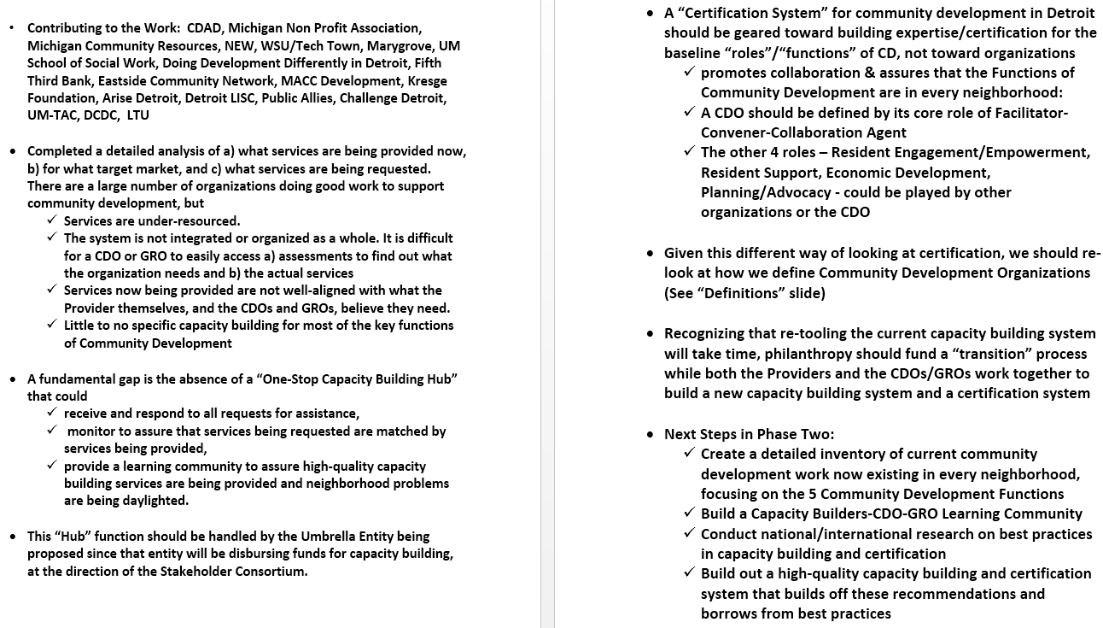
REPORT FROM THE CERTIFICATION & CAPACITY BUILDING SUBCOMMITTEE
Building the Engine of Community Development in Detroit

Slide 14
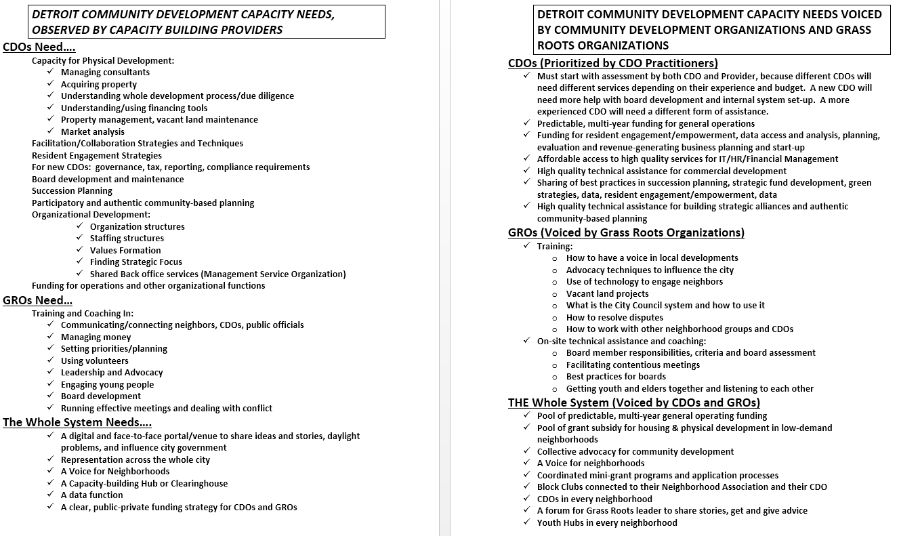
REPORT FROM THE CERTIFICATION & CAPACITY BUILDING SUBCOMMITTEE
Building the Engine of Community Development in Detroit

Slide 15
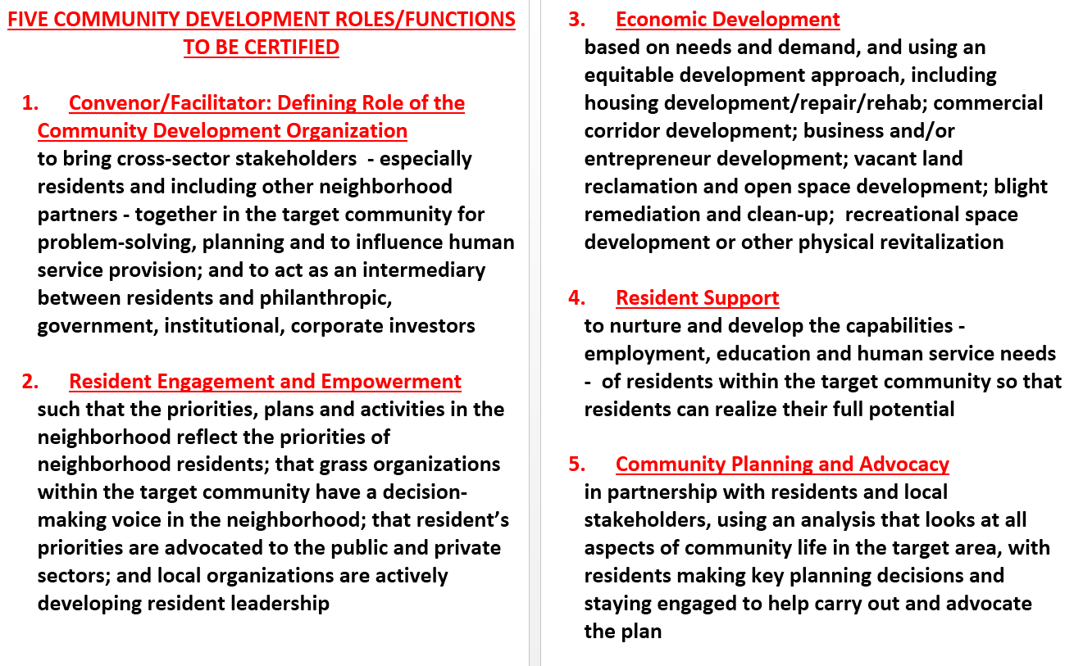
REPORT FROM THE CERTIFICATION & CAPACITY BUILDING SUBCOMMITTEE
Building the Engine of Community Development in Detroit

Slide 16
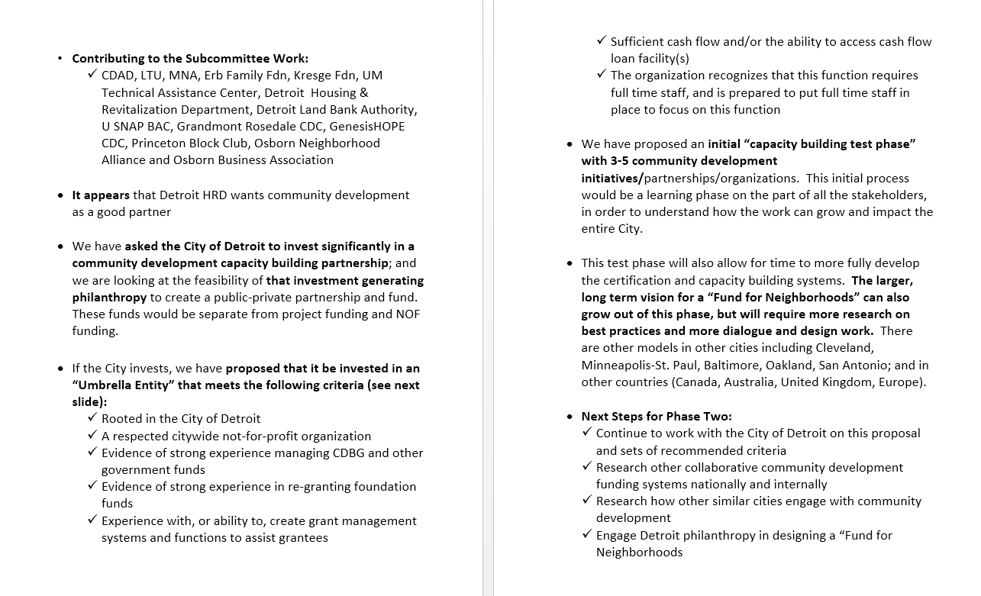
REPORT FROM THE PHILANTHROPY & CITY ENGAGEMENT SUBCOMMITTEE
Building the Engine of Community Development in Detroit

Slide 17
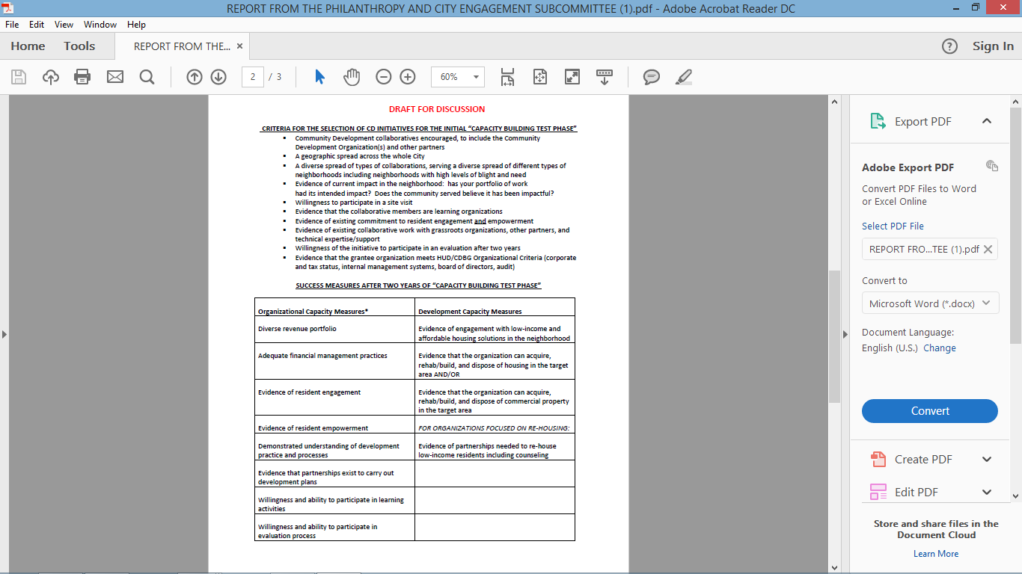
REPORT FROM THE PHILANTHROPY & CITY ENGAGEMENT SUBCOMMITTEE
Building the Engine of Community Development in Detroit

Slide 18
REPORT FROM THE PHILANTHROPY & CITY ENGAGEMENT SUBCOMMITTEE
Building the Engine of Community Development in Detroit

Slide 19
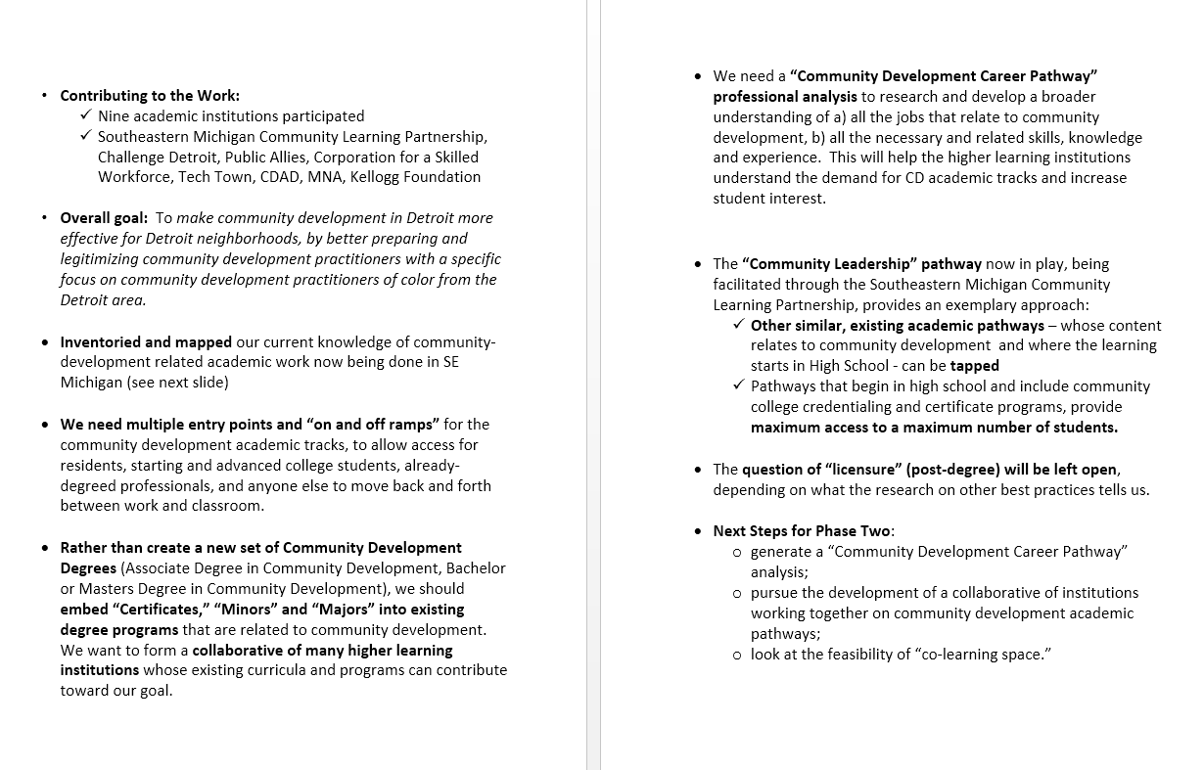
REPORT FROM THE CREDENTIALING & CAREER TRACKS SUBCOMMITTEE
Building the Engine of Community Development in Detroit

Slide 20
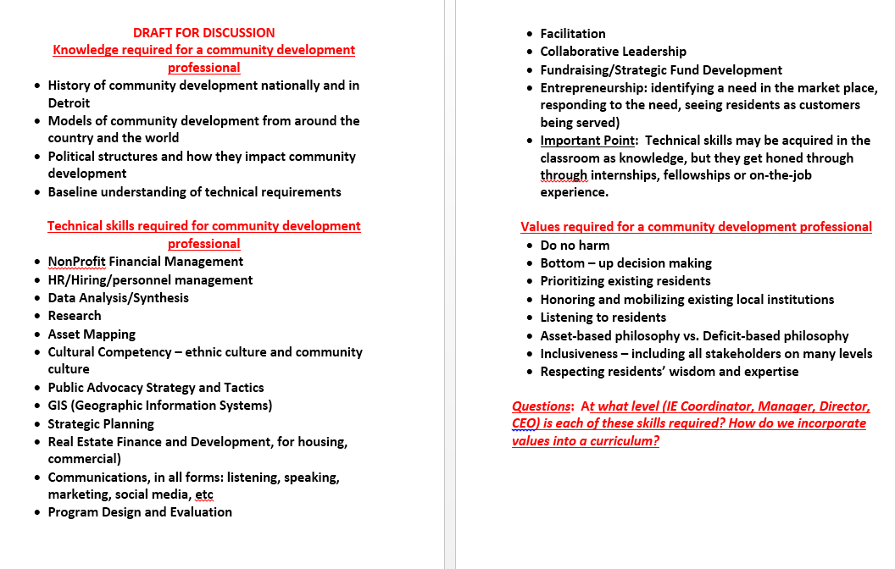
REPORT FROM THE CREDENTIALING & CAREER TRACKS SUBCOMMITTEE
Building the Engine of Community Development in Detroit

Slide 21
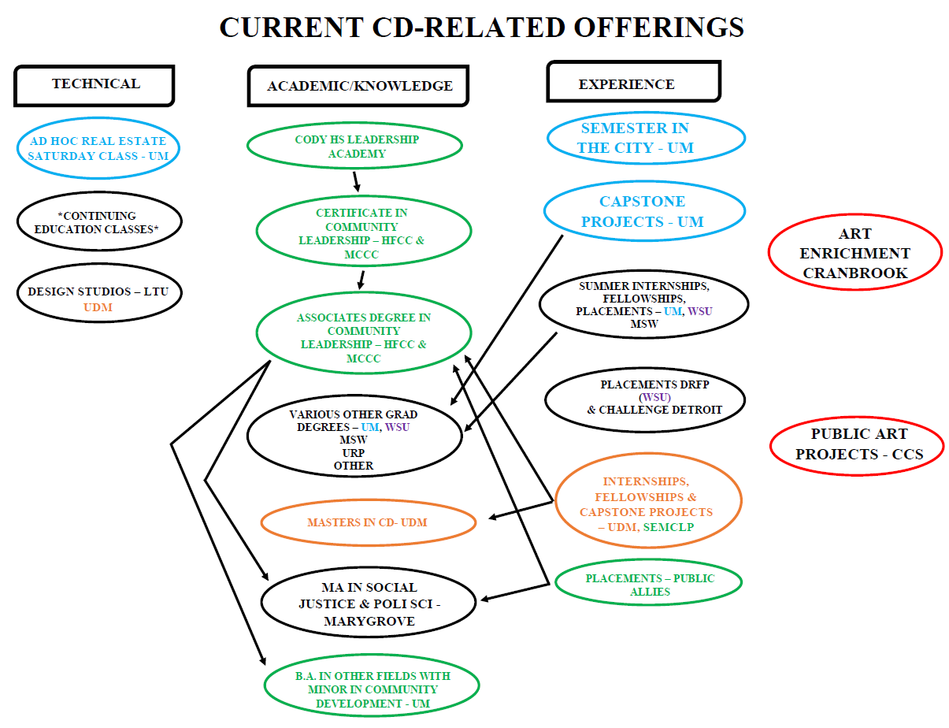
Building the Engine of Community Development in Detroit

