Slide 1
System Capitalization Task Force
July 21, 2021
Building the Engine of Community Development in Detroit

Slide 2
TODAY’S AGENDA
Intro’s and Outcomes – Chris Uhl
Updates/Next Steps – Chris Uhl w/ Maggie, Madhavi, Yolanda Jackson, and John Ziraldo
Presentation/Discussion: Updated Data on CD Capital in Play –
John, Maggie, Garland
Wrap-Up – Sherita Smith
Feedback on late August Alignment Forum #3
Next Meeting, Next Agenda

Slide 3
BECDD SYSTEM ELEMENT PROJECT UPDATES
5 BECDD System Element Projects Moving Forward to Implementation:
Element: Capacity Building
CD Capacity Building Delivery System – system design complete, now fleshing out details with CDOs; TA Pool for specialized Community Development functions in formation by CDAD; hoped-for launch in early 2022. (Lead: CDAD w/ “Solidarity Collective” supporting)
Element: City Engagement
Rebuilding Home Together Project – recent change in CDBG support from Mayor; now in process of identifying a different lead organization; working positively with several corporate/foundation funders to move
forward with necessary philanthropic support

Slide 4
BECDD SYSTEM ELEMENT PROJECT UPDATES, cont
Element: Education and Career Pipeline
Leadership Pipeline Project – Multiple partnerships in formation w/ DPSCD, DESC + several universities; Middle/High School CD Curriculum complete; implementation of some elements in 2021; identification of coordinating/lead organization in process. (Leads: Cody Rouge Community Action Alliance, Congress of Communities, Eastside Community Network, Urban Neighborhood Initiative)
Element: Data and Evaluation
Neighborhood Vitality Index Project – Phase One pilot done with results reported and modifications in process; Phase Two fundraising nearly completed; multiple innovative partnerships evolving. (Leads: D3 + JFM Consulting)
Element: Neighborhood Voice & Advocacy
Neighborhood Voice & Advocacy/Neighborhood Tables Project –
pilot done, learnings being compiled. (Lead: CDAD)

Slide 5
UPDATE: BECDD TRANSITION TO CDAD
Element: System Governance and Coordination
A Joint Committee comprised equally of CDAD BD and BECDD BSC has designed a structure to embed the BECDD system-building work inside CDAD
An affirmative vote was completed in mid-June by both entities to approve their recommendation
CDAD Board, BECDD Steering Committee and respective staff now at work to negotiate and implement various elements of the transition
Two-year funding goal about 85% complete to finish system-building process and complete transition; three foundations committed with
others considering

Slide 6
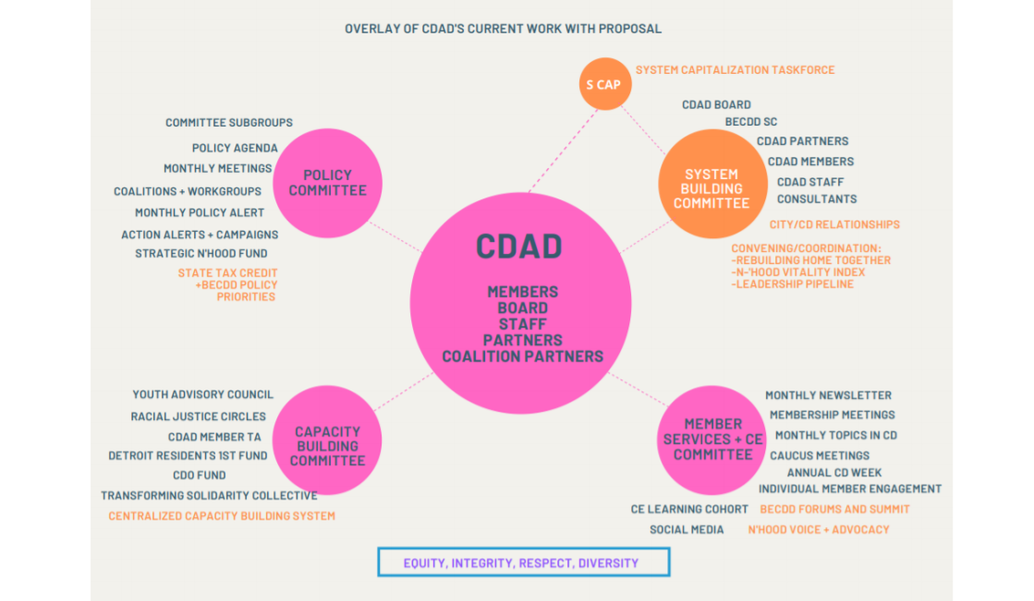
BECDD/CDAD TRANSITION STRUCTURE UNDER CONSIDERATION RANSITION STRUCTURE NOW UNDER CONSIDERATION TRANSITION STRUCTURE NOW UNDER CONSIDERATION

Slide 7
Element: System Capitalization System Capitalization Task Force Workplan Updates
PERVASIVE OBJECTIVES: ONGOING | STATUS AS OF JULY 2021
#1: POSITIVE AND SUPPORTIVE MIND-SET ON COMMUNITY DEVELOPMENT AND ITS VALUE | BSC (BECDD STEERING COMMITTEE) HAS THIS AS A MISSION PRIORITY; EXPECTED TO BE PART OF WORKPLAN THROUGH THE TRANSITION INTO CDAD.
#2: ADVANCES IN EQUITY IN CD FUNDING AND PRACTICE | BECDD “FUNDERS DISCUSSION GROUP” NOW MEETING REGULARLY TO FOCUS ON FUNDING EQUITY. “EQUITY-CENTERED COMMUNITY DEVELOPMENT IN DETROIT” PAPER SERVING AS BASIS FOR DISCUSSIONS. OUT-OF-TOWN FUNDING MODELS NOW BEING LOOKED AT.
#3: ALIGNMENT AND COORDINATION IN HOW RESOURCES FLOW INTO THE CD SECTOR | SECOND ALIGNMENT FORUM HELD MAY 24. “CDO” FUND (A POOLED FUND) NOW IN 2ND ROUND AT ENTERPRISE. MULTIPLE NEW INVESTORS HAVE JOINED THE CDO FUND, WITH OTHERS ACTIVELY CONSIDERING.
#4: A COUNCIL DISTRICT MODEL TO ASSURE EVERY C.C. DISTRICT HAS CD SUPPORT | WORK PAUSED IN 2020. DECISION ON WHETHER TO CONTINUE IN 2022, AFTER TRANSITION COMPLETED.

Slide 8
Element: System Capitalization System Capitalization Task Force Workplan Updates
NEAR-TERM OBJECTIVES: BY LATE 2020 | STATUS AS OF JULY 2021
#5: NEW SOURCES OF FUNDING FOR THE CD ECO-SYSTEM
#5A: REVISED: CREATE AN INTEGRATED STRATEGY W/ CEDAM, CDAD, MSHDA AND MEDC FOR JOINT ADVOCACY ON MORE RESOURCES FOR THE CD SECTOR, INCLUDING THE TAX CREDIT INCENTIVE LEGISLATION OFFERED THRU CEDAM AND BECDD IN 2020. | NEW RECOMMENDATION APPROVED BY TASK FORCE. NEW (R) SPONSORS ON LEGISLATION IDENTIFIED, LEGISLATION BEING UPDATED AND EXPECTED TO BE RE-INTRODUCED THIS YEAR. MSHDA’s “HCD FUND” IN LINE FOR FUNDING, ANNOUNCEMENT BY GOVERNOR IN LATE JULY; MINIMUM $10 MIL.
#5B: USE OF COVID/CARES FUNDING FOR CD SECTOR. USE OF ARP FUNDING. OTHER STRATEGIES TO ENHANCE FEDERAL RESOURCES FOR COMMUNITY DEVELOPMENT INCLUDING CDBG, HOME, MHT AND OTHERS. | ARP FEEDBACK SENT TO MAYOR, RENCHER, TRUDEAU AND HEIDEL. $10 MILLION IN MINI-GRANTS, ALLOCATION FOR HOME REPAIR. SINGLE FAMILY REHAB FUNDING WON’T BE INCLUDED IN CITY PACKAGE
#6 ADEQUATE FUNDING FOR THE "COORDINATION" DRIVER OF THE ECO-SYSTEM
#6A: EXPANSION OF POOLED CDO CAPACITY FUND @ ENTERPRISE (KRESGE AND FORD) | KELLOGG AND WILSON FOUNDATIONS ADDED TO KRESGE AND FORD & ADDITIONAL FOUNDATIONS CONSIDERING INVESTING IN CDO FUND
#6B: INVESTMENT IN CDAD-BECDD SYSTEM COORDINATION STRATEGY | $750,000 RAISED FOR 2021-2022, MORE EXPECTED

Slide 9
Element: System Capitalization System Capitalization Task Force Workplan Updates
MID-TERM OBJECTIVES: BY LATE 2021 | STATUS AS OF JULY 2021
#5: NEW SOURCES OF FUNDING FOR THE CD ECO-SYSTEM
#5A: REVISED: CREATE AN INTEGRATED STRATEGY W/ CEDAM, CDAD, MSHDA AND MEDC FOR JOINT ADVOCACY ON MORE RESOURCES FOR THE CD SECTOR, INCLUDING THE TAX CREDIT INCENTIVE LEGISLATION OFFERED THRU CEDAM AND BECDD IN 2020. | NEW RECOMMENDATION APPROVED BY TASK FORCE. PARTNERSHIP WITH BECDD-CEDAM SIGNED. NACC COALITION RESUMED MEETINGS. GOOD PROGRESS FINDING NEW (R) SPONSORS ON LEGISLTION, WHICH IS EXPECTED TO BE RE-INTRODUCED THIS YEAR.
#5B: CO-CREATED CITY GOVT “COMMUNITY DEVELOPMENT DELIVERY SYSTEM” | EARLY THOUGHTS NOW IN FORMATION BY CITY. SHOULD BE INTEGRATED WITH STRATEGIES RELATED TO CDBG.
#5C: ANNUAL SET-ASIDES IN CDBG BUDGET, AND OTHER STRATEGIES TO ENHANCE FEDERAL RESOURCES FOR COMMUNITY DEVELOPMENT INCLUDING HOME, MI HOUSING TRUST FUND. | THESE CONVERSATIONS STARTING. NEED TO COLLABORATE AND COORDINATE WITH CDAD TO DECIDE ON JOINT GOAL(S) AND AN ADVOCACY STRATEGY FOR 10-YEAR PLAN.
#5D: A COORDINATED MODEL FOR CRA-RELATED BANK FUNDING | INFORMAL, FOCUSED CONVERSATIONS NOW UNDERWAY TO CREATE A COLLABORATIVE,PROJECT-BASED SF REHAB FINANCING MODEL, AND TO ASSESS SYSTEMIC CREDIT GAPS IN DETROIT, BRINGING RESIDENT VOICE INTO THE CONVERSATION TO IDENTIFY BARRIERS, AGREE ON GOALS

Slide 10
Element: System Capitalization System Capitalization Task Force Workplan Updates
MID-TERM OBJECTIVES (CON'T): BY LATE 2021 | STATUS AS OF JULY 2021
#6: ADEQUATE FUNDING FOR THESE KEY DRIVERS OF A CD ECO-SYSTEM: ADVOCACY, CAPACITY, KNOWLEDGE | INTEGRATED FUNDRAISING STRATEGY IN PLAY: LEAD WITH SYSTEM PROJECTS, FOCUS ON INVESTMENT INTO WHOLE SYSTEM
#6A: FUNDING FOR THE CAPACITY BUILDING AND LEADERSHIP PIPELINE | DESIGN WORK COMPLETE ON CDO/GRO DELIVERY SYSTEM. “READINESS TO LAUNCH” FUNDING TO COMPLETE DETAILS, EXPECTED THIS SUMMER. LEADERSHIP PIPELINE DESIGN WORK IN PROGRESS, SOME COMPONENTS EXPECTED TO LAUNCH THIS YEAR. LEAD CDOs NOW WORKING ON FUNDRAISING TO BEGIN IMPLEMENTATION. LEAD ORGANIZATION DISCUSSIONS UNDERWAY.
#6B: FUNDING FOR THE NEIGHBORHOOD VOICE AND ADVOCACY FRAMEWORK | BUDGET BEING FINALIZED, INCORPORATED INTO INTEGRATED FUNDRAISING STRATEGY.
#6C: FUNDING FOR REBUILDING HOME TOGETHER (SINGLE FAMILY REHAB PROJECT W/ CITY OF DETROIT) | MAYOR OFFERING SOME CDBG GAP FUNDING. DFC AND CDOs NOW JOINTLY FUNDRAISING FROM PHILANTHROPY. NEW LEAD ORGANIZATION BEING IDENTIFIED.
#6D: EXPANSION FUNDING FOR THE NEIGHBORHOOD VITALITY INDEX | PHASE ONE PILOT FUNDING ACHIEVED. PHASE TWO PILOT FUNDING NEARLY COMPLETE. SEVERAL INNOVATIVE PARTNERSHIPS FORMING.
#7: A TEN YEAR PLAN FOR A SUSTAINABLE COMMUNITY DEVELOPMENT SYSTEM FOR DETROIT’S NEIGHBORHOODS | “LIVING DOCUMENT.” LEARNINGS FROM CURRENT WORK WILL BE INCORPORATED. FIRST OUTLINE OF PLAN EXPECTED IN SEPTEMBER.

Slide 11
BECDD Funders Discussion Group
June 2021 Meeting: 5 Foundations, 5 Corporations, 2 Intermediaries
Reviewed “snapshot” of data being researched on how community development capital is deployed around each Council District
Presentations from the Borealis Fund and the California Funders 4 Justice
Kevin Ryan/Chris Polk now doing one-on-one interviews with all members of the Funders Discussion Group to get their perspectives on equity in funding
Next Meeting August 9: Report and Suggestions from the Interviews

Slide 12
Preliminary Research Learnings on Community Development “Capital in Play,” 2018 & 2019

Slide 13
How to view this data
This is a view of the preliminary data and findings of a fuller report now being developed, on community development funding in Detroit. The fuller report should contain more foundation data from 2020, and it will contain a series of mapped “overlays” so that the Task Force can more fully understand the data and its implications.
This data is a follow up to BECDD’s report on 2018 funding. In the 2018 report, the focus was on comparing existing “capital in play” for community development, to a fully-resourced citywide community development system. This report updates 2018 data (to 2020); and disaggregates the data by geography, by uses of funding, and by organizations receiving the funding. This report also looks at the data from an “equity” lens.
The data is drawn from a sample of 7 private foundation, 2 public funders and Invest Detroit’s SNF initiative, who provided funding data for 2018 and 2019. We expect to receive data from one additional major foundation funder.
The updated data does not include bank data; banks were unwilling to share their data.
As it is more fully developed, this research will inform the creation of the BECDD’s System Capitalization Task Force’s Ten-Year Strategic Plan to Resource a Community Development System for Detroit

Slide 14
What we are learning so far
There is a clear disparity in the allocation of community development grant funding to different city council districts in Detroit. This disparity is different for private foundation funding than for public funding.
This disparity is likely a driver of inequitable community development in Detroit neighborhoods; as community development stakeholders it’s important for us to discuss why this is so.
There appears to be a significant increase in funding for community development “core functions,” especially resident engagement, facilitation and CDO operating support, since 2018
Banks and other corporate funders have been unwilling to share grant data in a way that allows for it to be aggregated and analyzed with other funding data. Greater transparency in all parts of the community development ecosystem is needed to advance equity and stakeholders will need a common method to track community development grant funding to achieve alignment and impact.

Slide 15
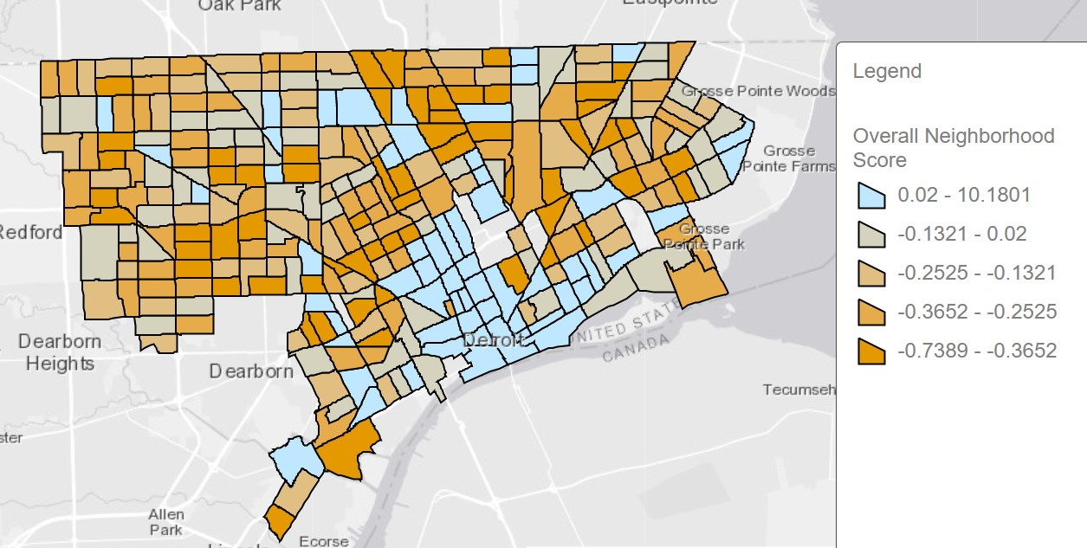
The Neighborhood Score

Slide 16
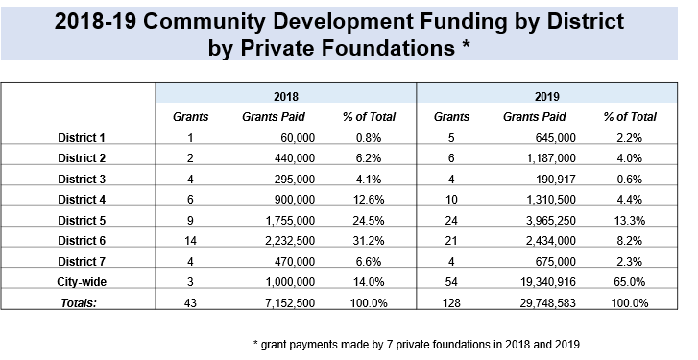

Slide 17
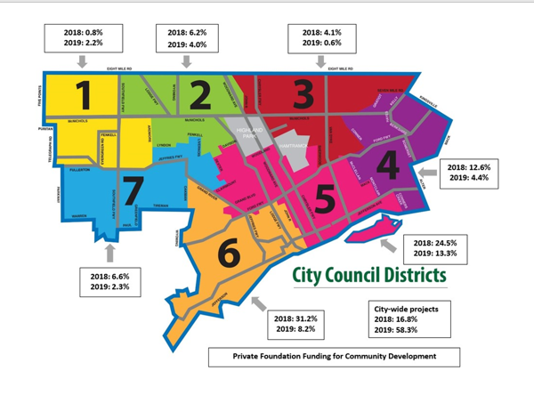

Slide 18
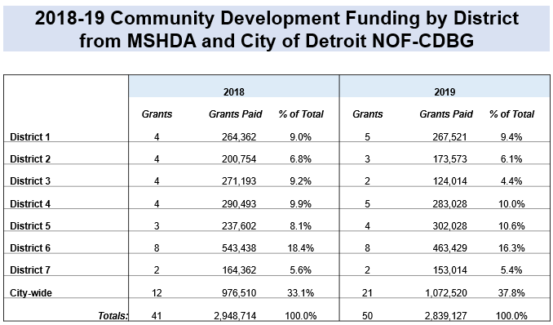

Slide 19
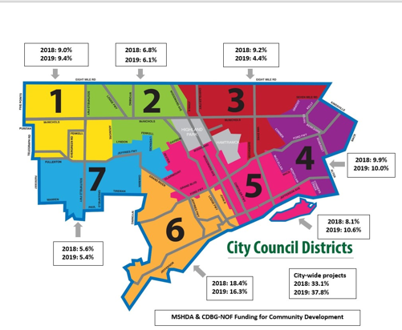

Slide 20
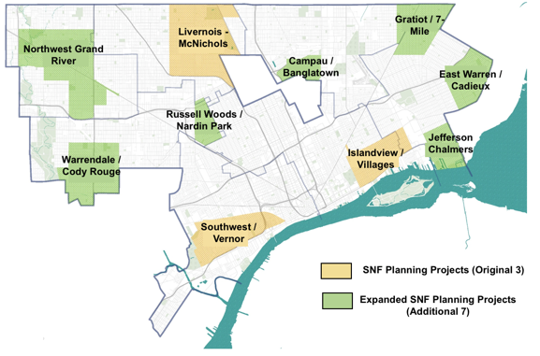

Slide 21
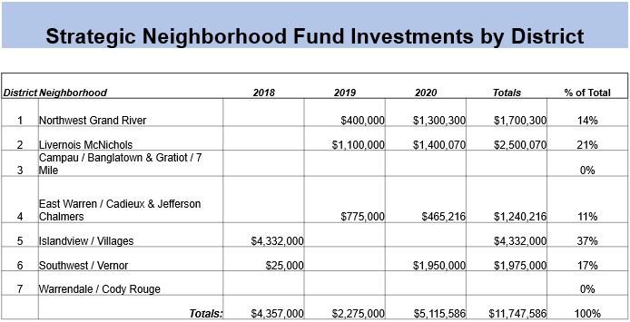

Slide 22
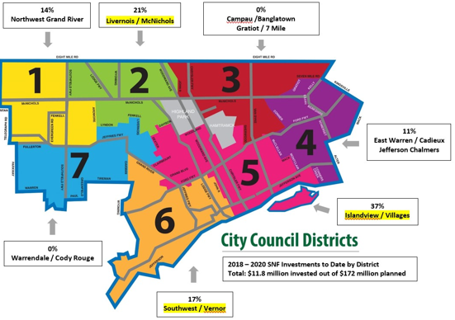

Slide 23
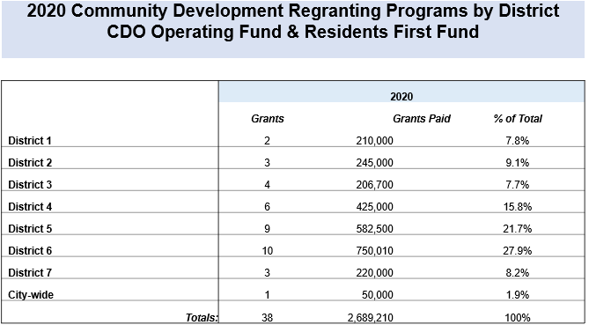

Slide 24
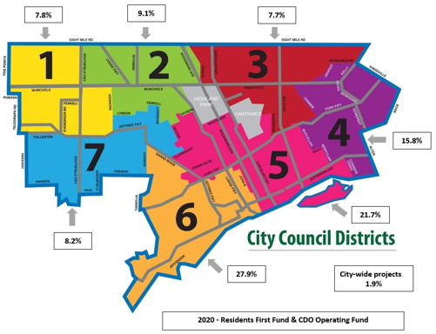

Slide 25
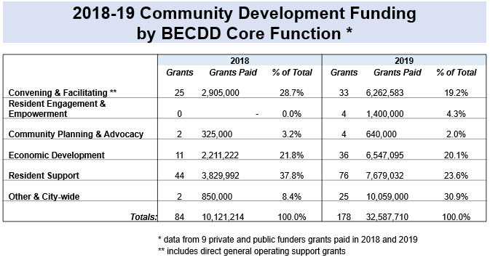

Slide 26
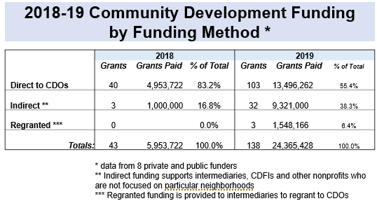

Slide 27
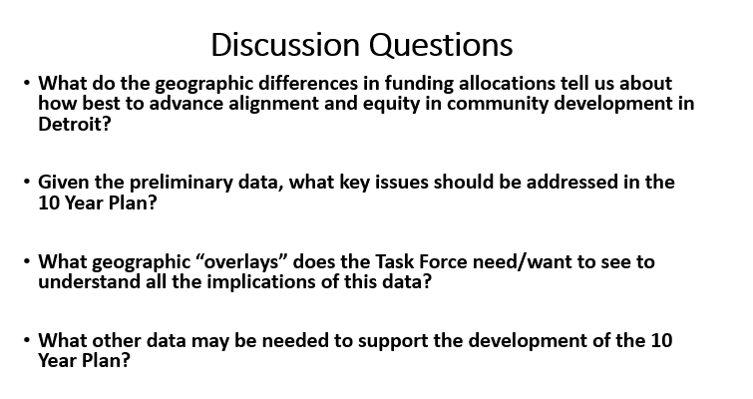

Slide 28
3RD ALIGNMENT FORUM
PROPOSED DATE: LATE AUGUST, 3-5 PM
SEEKING ALIGNMENT: CAPITAL, CAPACITY AND COMMITMENT FOR EQUITABLE REAL ESTATE DEVELOPMENT IN DETROIT
SUGGESTED MODERATORS:
CHASE CHANTRELL, BUILDING COMMUNITY VALUE
WHO ELSE?
SUGGESTED FORMAT:
INVITATION ONLY, SAME DIVERSE GUEST LIST
PANELISTS: CHRIS UHL, SHERITA SMITH, OTHERS?
MODERATED DEBATE
FORMING CONSENSUS

Slide 29
AGENDA:
PRESENTATION/DISCUSSION OF FIRST DRAFT OUTLINE OF TEN-YEAR STRATEGY
MORE DETAILS ON PROPOSED
CRA FOLLOW UP
CONTINUED DISCUSSION ON THE CDBG ADVOCACY STRATEGY
NEXT STEPS ON STATEWIDE ADVOCACY STRATEGY/STATEWIDE LEGISLATION
PLANNING FOR 4TH ALIGNMENT FORUM
NEXT MEETING OF THE TASK FORCE
WEDNESDAY, SEPTEMBER 1, 2021

