Slide 1
Spatial/Structural Racism and its Implications for Detroit’s Neighborhoods
Peter J. Hammer
Professor of Law and Director
Damon J Keith Center for Civil Rights
Wayne State University Law School
Building the Engine for Community Development in Detroit
December 13, 2018

Slide 2


Economic & racial justice

Slide 3
Provocative claim . . . .
Spatial-Structural Racism lies at the heart of Detroit's economic challenges, regional inequity and endemic poverty
Traditional economic development strategies can compound, rather than redress racial inequality
How do we lay the foundation to take meaningful economic action for Detroit neighborhoods?
We need new approaches and strategies

Slide 4
What determines where we live?
What social, economic and political forces shape demographic patterns?
Importance of spatial perspectives
The spatialization of race
The racialization of space
1950s-2010s: Era of white flight, abandonment and segregation at the regional level
2010-present: Era of re-colonization and displacement

Slide 5
Address structural racism and health through the same frame
Mapping Opportunity
Michigan Roundtable-Kirwan Institute Opportunity Mapping (2008)
Defining Opportunity
Housing
Employment
Schooling
Health
Transportation
Food security
Living environment

Slide 6
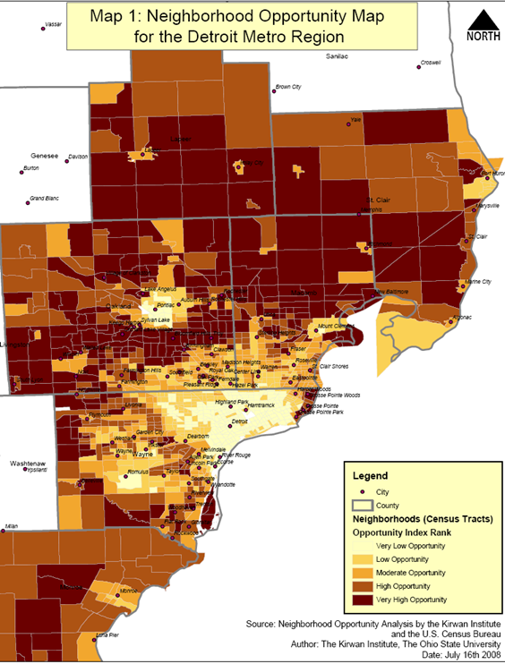
Segregation wealth & opportunity

Slide 7
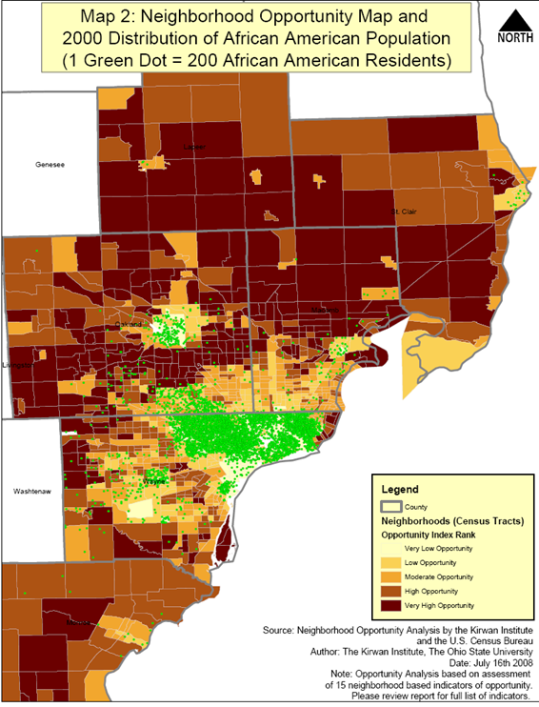
Spatial Racism in S.E. Michigan

Slide 8
Implications of Spatial Racism for economic markets
We live in a dysfunctional two-tiered regional economy (separate and unequal)
We are segregated by economics & race
Detroit neighborhoods ARE NOT part of the same economy as the rest of the region
Standard economic development models WILL NOT work for Detroit neighborhoods
Downtown Detroit is linked to the suburbs not the neighborhoods
There never will be trickle down or spill over effects
Notes:
The most important slide in the presentation

Slide 9
No markets exist in neighborhoods
No job market
No super-markets
No mortgage market
No credit market
No housing market
No auto insurance market
No transportation market

Slide 10
Implications? We have narrow development & broad displacement
Narrow Development
Development targeted to 7.2 miles and other isolated pockets
Minimal investment in neighborhoods
Broad Displacement
Water shutoffs
Tax-foreclosures
Increased rents
Gentrification

Slide 11
Need to re-imagine development
Traditional systems have failed
Detroit is the biggest economic market failure in American history
Failed economic markets
Deindustrialization, disinvestment, subprime lending, record levels of endemic poverty and spatial racism
Failed political markets
Emergency Management, Bankruptcy Plan of Adjustment, Fiscal Oversight, gerrymandering

Slide 12
Need two-track development strategy
Track One: Immediate strategies of self-help, self-empowerment and self-determination
Black Panther 10 point plan and community services
Detroit Black Community Food Security Network
Track Two: Longer-term strategies of regional economic integration on new terms
Inclusive development
Community Benefits Ordinance
Intentionally build new economic & political markets

Slide 13
Example: Flipping the capital-labor ratio
Ratio of capital to labor depends on relative cost of capital and labor
Expensive capital => use more labor
Expensive labor => use more capital
Detroit: relatively cheaper labor than capital
Implications
Blight removal
Municipal services
Green infrastructure

Slide 14
Example: New approaches to housing
Current status
No commercial mortgage market
“credit worthy” is code for excluding historic residents
Spiral: shortage of affordable housing and increasing rents
New approaches
Land contracts from Land Bank for historic residents
Rehab existing housing stock not build new houses
Connect housing rehab to workforce development and small business creation

Slide 15

What are lessons from abroad?

Slide 16


Human capabilities = Growth

Slide 17
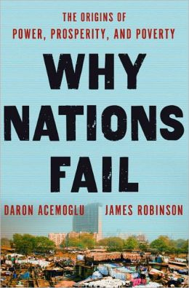
Political and economic inclusion = Growth

Slide 18

Decrease income inequality = Growth

Slide 19
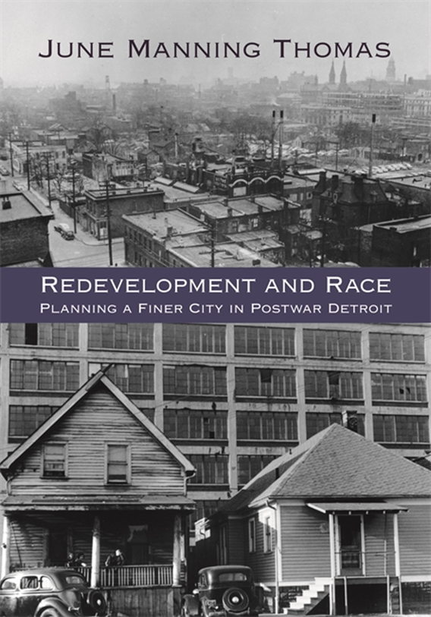
These lessons are not new . . .

Slide 20
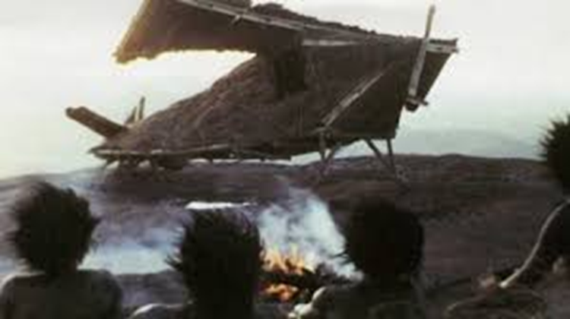
Traditional economic development as a modern “Cargo Cult”

Slide 21

Discussion . . .

